Slide 1
DIGIT AND LETTER: RECOGNITION AND CLASSIFICATION
Harsh Parikh
Sanket Nitin Wagh

Slide 2
PROBLEM STATEMENT
The Problem:
It has become important to extract and recognize the data efficiently. For example, form filling has become a thing of the past.
Forms and bank checks can now be filled and scanned via mobile apps.
To successfully recognize the data is not easy.
The Appoach used:
Our primary objective is to perform recognition of the data. This data is given by the user. We will also be using the MNIST dataset. We plan to analyze if there is an improvement in predictions of digits written by users
The classifiers that we will build are going to be done using K-Nearest Neighbors, Principal Component Analysis and Random Forests.
We will compare the results obtained using the datasets to verify whether our models work effectively.

Slide 3
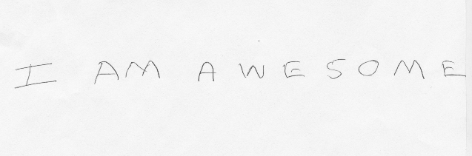

FEATURE EXTRACTION
OpenCV was used to extract features.
Preprocessing consisted of using Gray-Scale to avoid clash colors.
The advantage is that we can set a threshold based on which characters are converted to white and background is converted to black.
Gaussian blur is used.

Slide 4
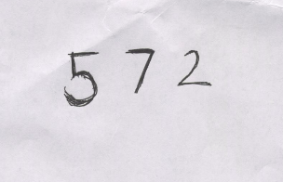
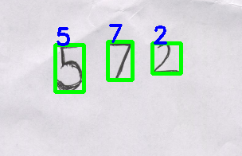
K-Nearest Neighbor
Instance based lazy algorithm
Euclidean distance is used in the first step. Distance between given datapoints obtained.
‘K’ most similar instances selected.
‘Response’ provided by selected neighbors. This is the prediction of class.

Slide 5
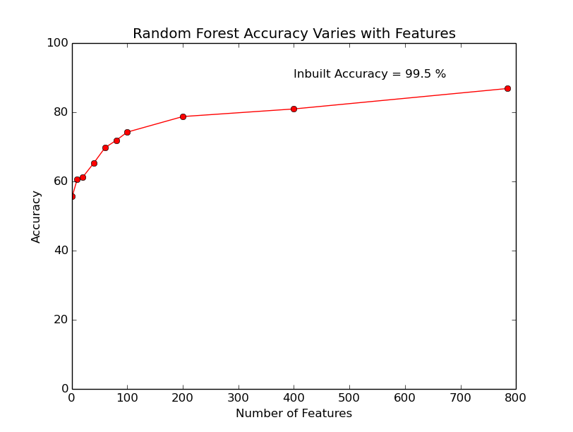
K-NN WITH PRINCIPAL COMPONENT ANALYSIS
PCA is used to identify patterns.
Projects data onto a smaller subspace.
Reduces dimensions of the data.
We use this aspect and determine accuracy values for various dimesnions of data.

Slide 6
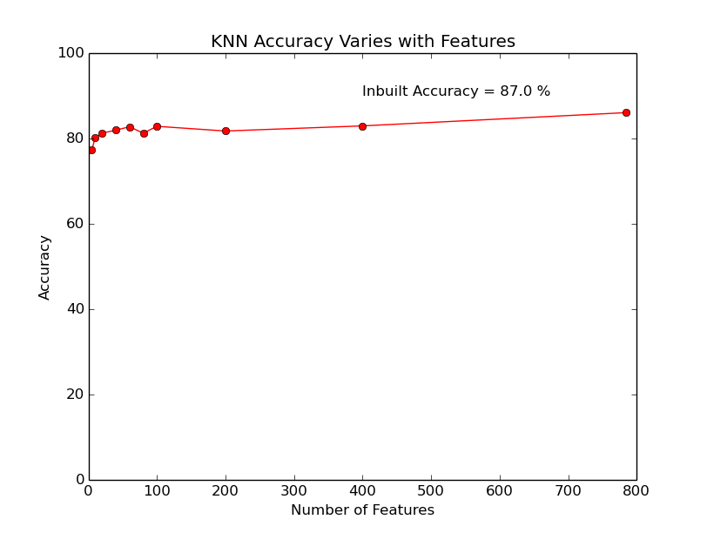
RANDOM FORESTS
Capable of regression and classification. We will focus on classification.
Data divided into sample subsets.
Each subset of data generates a decision tree. This helps obtaining a stronger outcome as compared to a single tree.
Each tree classifies the data and produces a result. The aggregate result is utilized.
This provides a more efficient result.

Slide 7
CONCLUSION
Notable results:
When MNIST data was classified using our classifier it performed approximately 1% less efficiently than the inbuilt classifier.
When the K-NN algorithm was used on letter-recognition data, our classifier was outperformed by the inbuilt classifier by 2.88%.
We applied PCA on the data to reduce dimensions. As this was done, our classifier was outperformed by the inbuilt functions by 1%.
Application of Random Forest yielded an accuracy less than 10% than that of the inbuilt functions.

Slide 8
REFERENCES
[1] Dr. Y Venkateswarlu, U Ravi Babu, Aneel Kumar Chintha, “Handwritten Digit Recognition Using K-Nearest Neighbour Classifier”
[2] Nyssa Aragon, William Lane, Fan Zhang, “Classification of Hand-Written Numeric Digits”
Links:
[1]http://ieeexplore.ieee.org/stamp/stamp.jsp?tp=&arnumber=6755106 (Paper 1)
[2]http://cs229.stanford.edu/proj2013/AragonLaneZhang-ClassifyHandWrittenNumericDigits.pdf ( Paper2 )
[3]http://yann.lecun.com/exdb/mnist/ (MNIST Dataset)
[4]https://www.stat.berkeley.edu/~breiman/random-forests.pdf (Random Forest Implementation)
[5]http://www.analyticsvidhya.com/blog/2015/09/random-forest-algorithm-multiple-challenges/ (Random Forest Implementation)
[6]http://sebastianraschka.com/Articles/2014_pca_step_by_step.html (Principal Component Analysis implementation)
[7]http://machinelearningmastery.com/tutorial-to-implement-k-nearest-neighbors-in-python-from-scratch/(K-NN Classifier implementation)
THANK YOU

